Slide 1

CNOE – Cloud Native Operational Excellence for Internal Developer Platforms
Nima Kaviani
Manabu McCloskey
Brandon Leach
Principal Architect
AWS
Senior Architect
AWS
Sr Director of Dev Platforms
Autodesk
Notes:
Backstage ROI: https://backstage.spotify.com/blog/how-spotify-measures-backstage-roi/

Slide 2
Background

Slide 3
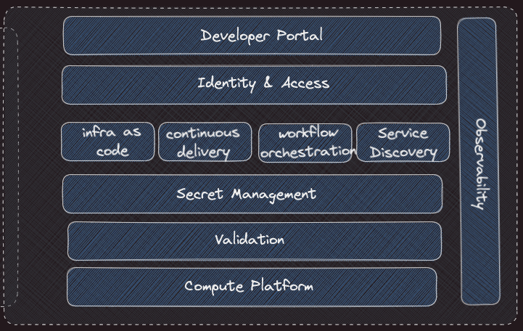
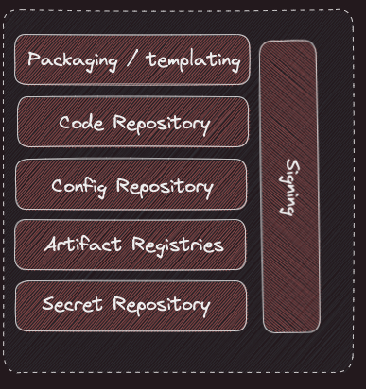
Internal Developer Platform - Capabilities

Slide 4
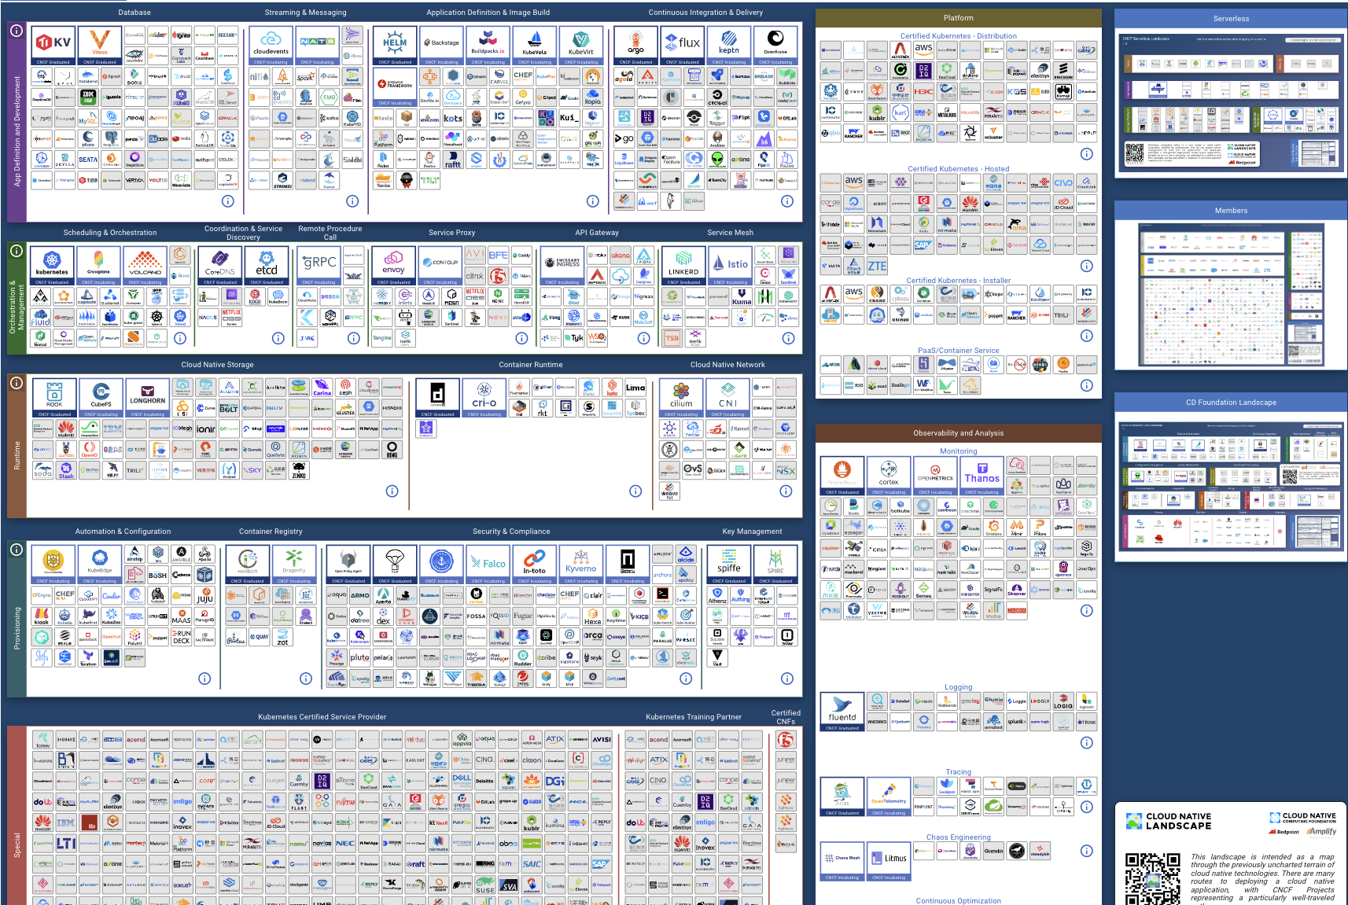

Slide 5

Have you seen a
Solution?

Slide 6
Constructing a Distribution

Slide 7
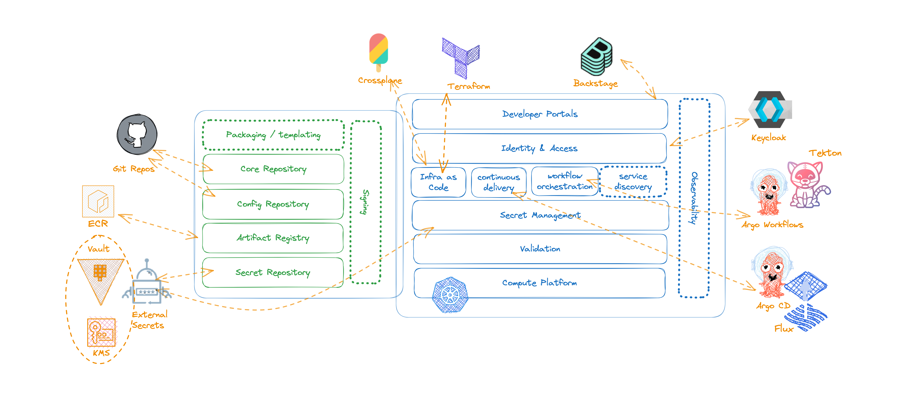
Reduced Technology Choices
Notes:
It is not supposed to be a one size fits all type of solution
We have built modular bits that can be taken and composed at every companies own discretion
Through the collaboration, you will have a wealth of expertise for like minded experts in the space to bounce ideas off of
At the same time, integration with the internals of your own IDPs at your own company is a responsibility that you will assume yourself

Slide 8

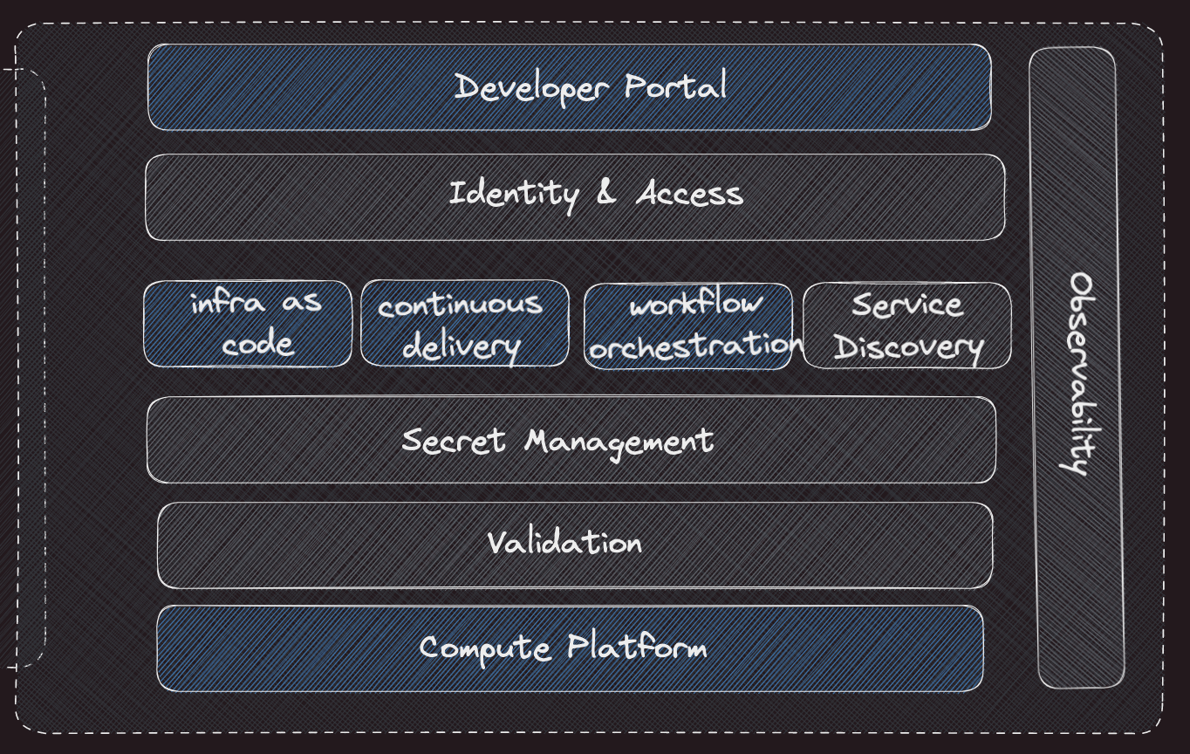
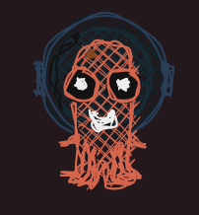


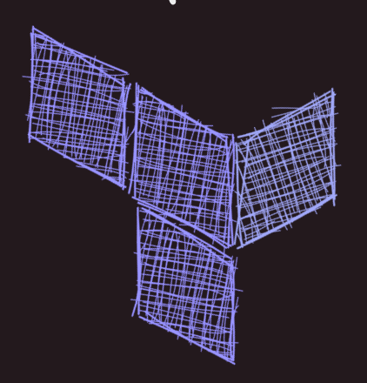

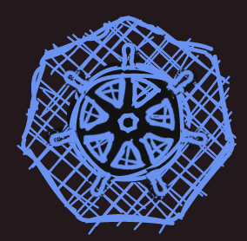
Reduced Technology Choices
Backstage
Argo CD / Flux
Argo Workflows
Tekton
Terraform / Crossplane
Kubernetes

Slide 9

A Linux distro
is an operating system made from a software collection that is based upon the Linux kernel and, often, a package management system.

Slide 10

An IDP Distribution
is a developer platform made from a software collection that is based upon Kubernetes, as well as a package management system.

Slide 11
CNOE is an internal developer platform (IDP) distribution built in the open in collaboration with the user community powered by CNCF technologies

Slide 12
Why does building a Distribution matter?
It gets us past technology choices
The focus shifts on improving technologies used
We shift to defining best practices

Slide 13
Technology
Choices

Slide 14
Technology Selection Criteria
Kubernetes as the underlying platform
open source projects (preferably CNCF)
right level of maturity
strong signals on the adoption

Slide 15
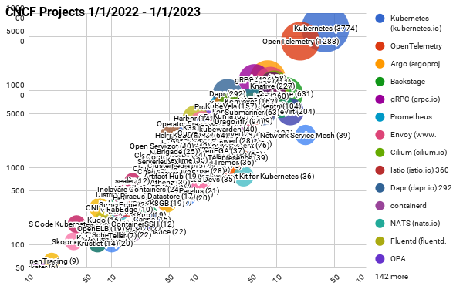
CNCF Velocity Graphs 2023

Slide 16
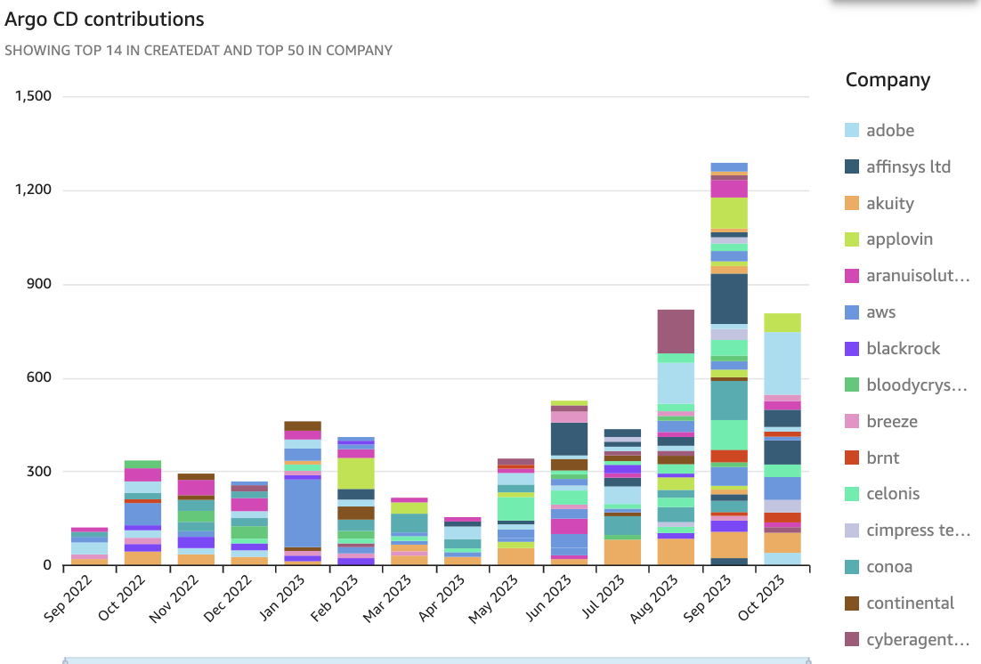
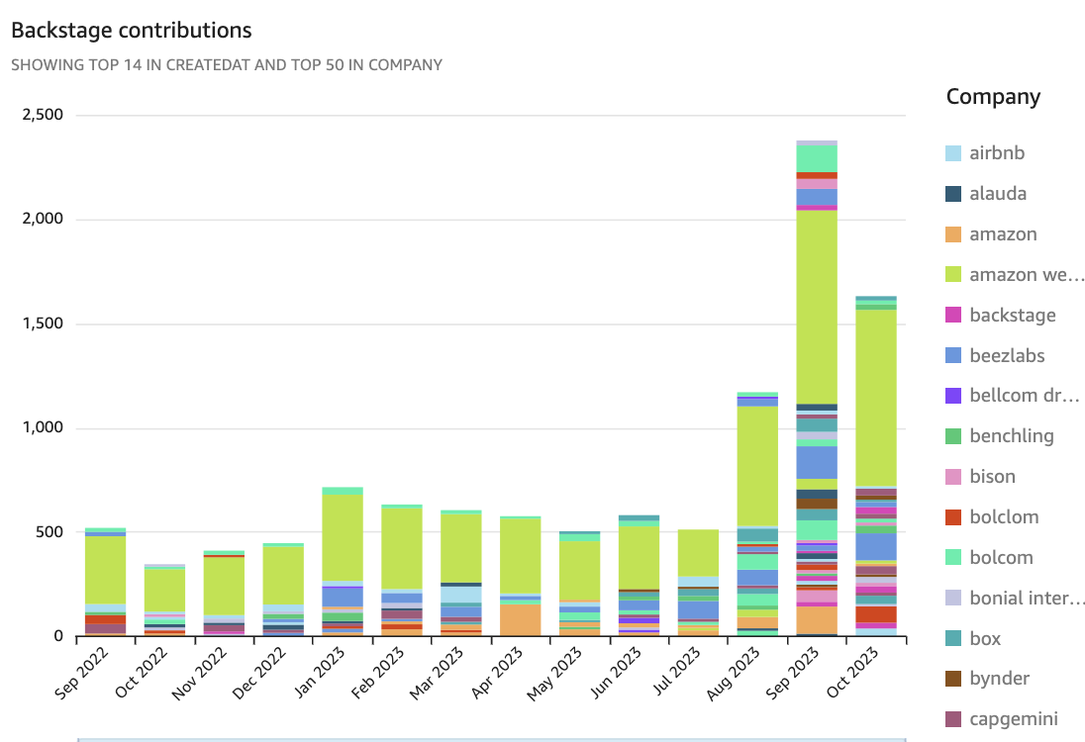
GitHub Contributions

Slide 17
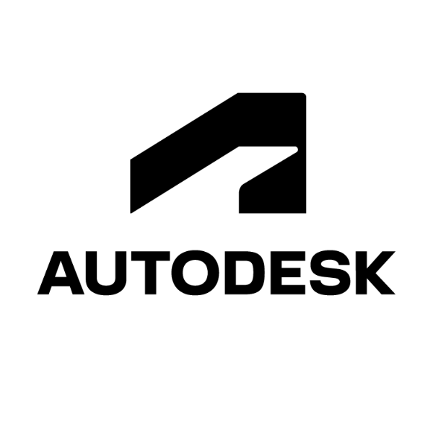

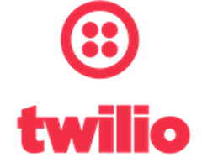

Scale of Operation

Slide 18
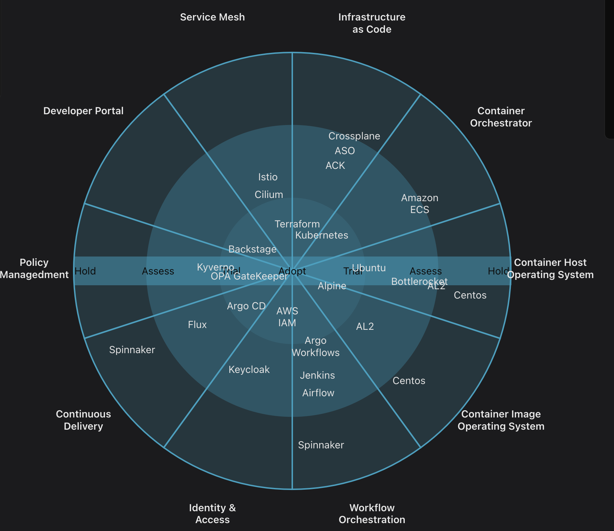
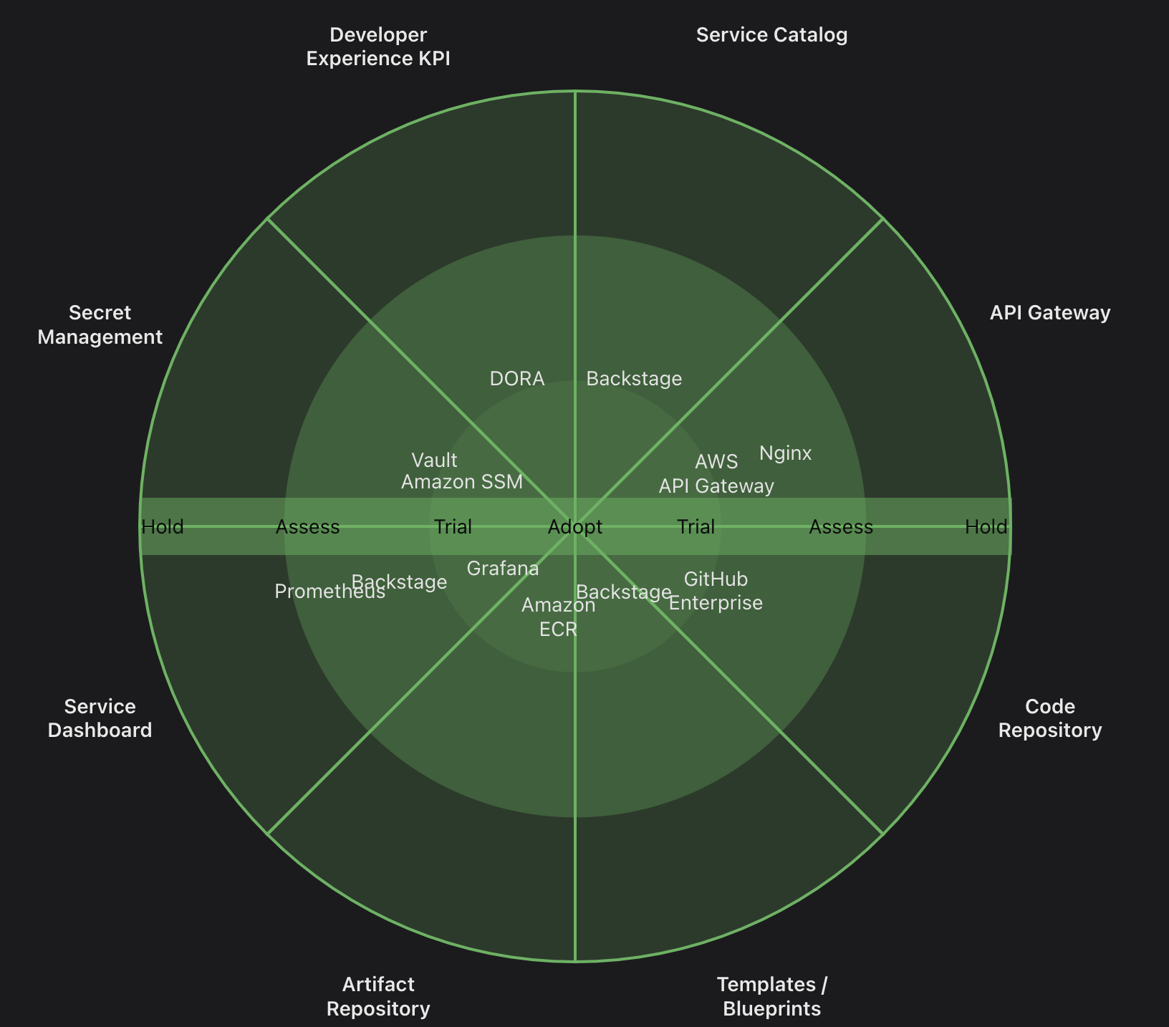
Technology Radars

Slide 19
Technology
Improvements

Slide 20

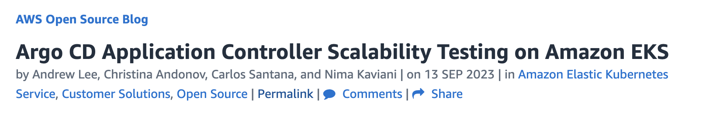
Scalability Work
10,000 Argo CD Applications
100 Clusters
Performance Improvements
Configuration Tuning
Part 1: http://bit.ly/3QtFnM5

Slide 21
Scalability Work
50,000 Argo CD Applications
5,000 Clusters
Performance Improvements
New Sharding Algorithms
Configuration Tuning
Argo Workflows Scalability
Backstage Auth Mechanism

Slide 22
Best
Practices

Slide 23
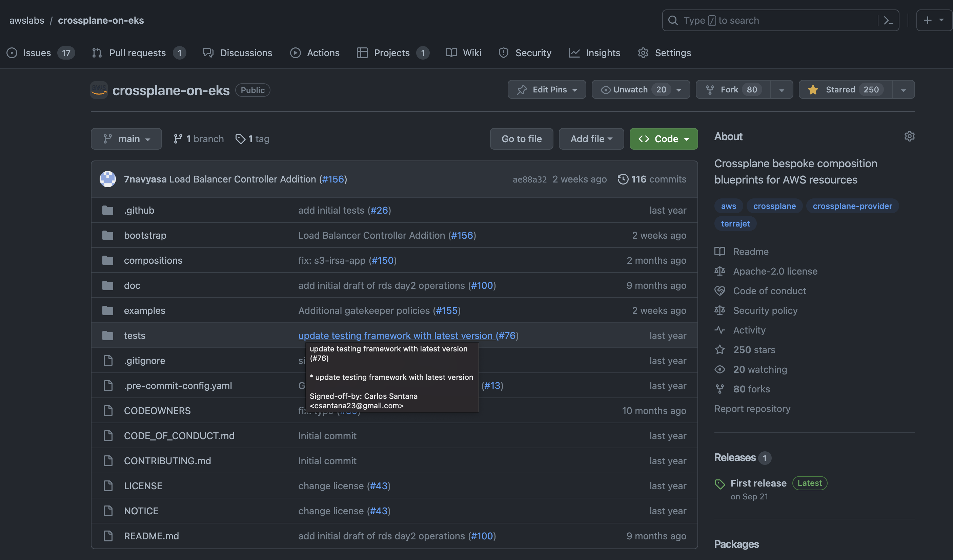
Crossplane Patterns
https://github.com/awslabs/crossplane-on-eks

Slide 24
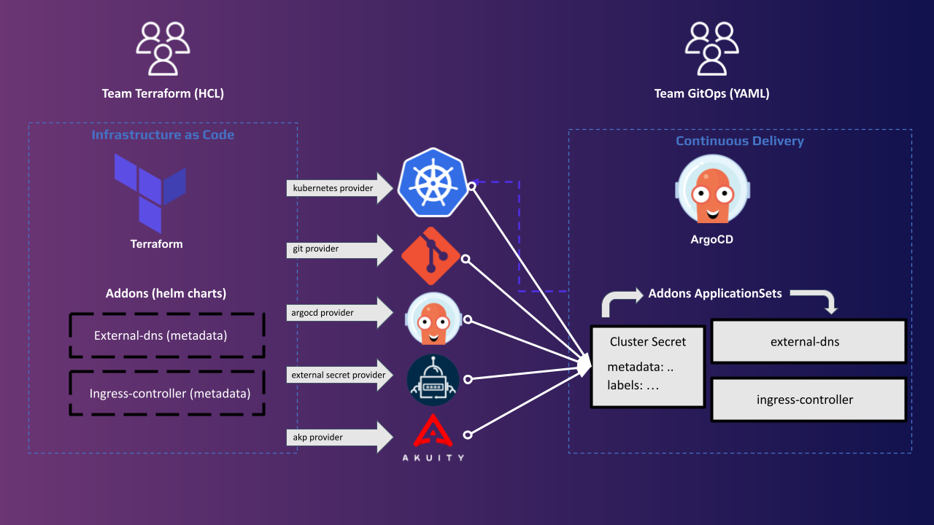
GitOps Bridge
https://github.com/gitops-bridge-dev

Slide 25

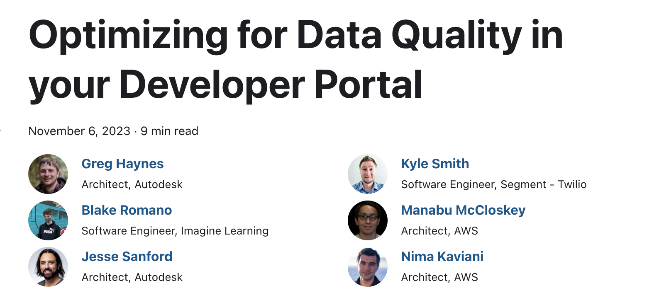
Developer Portal Best Practices
Backstage plugins
Developer practices

Slide 26
Packaging
Technologies

Slide 27
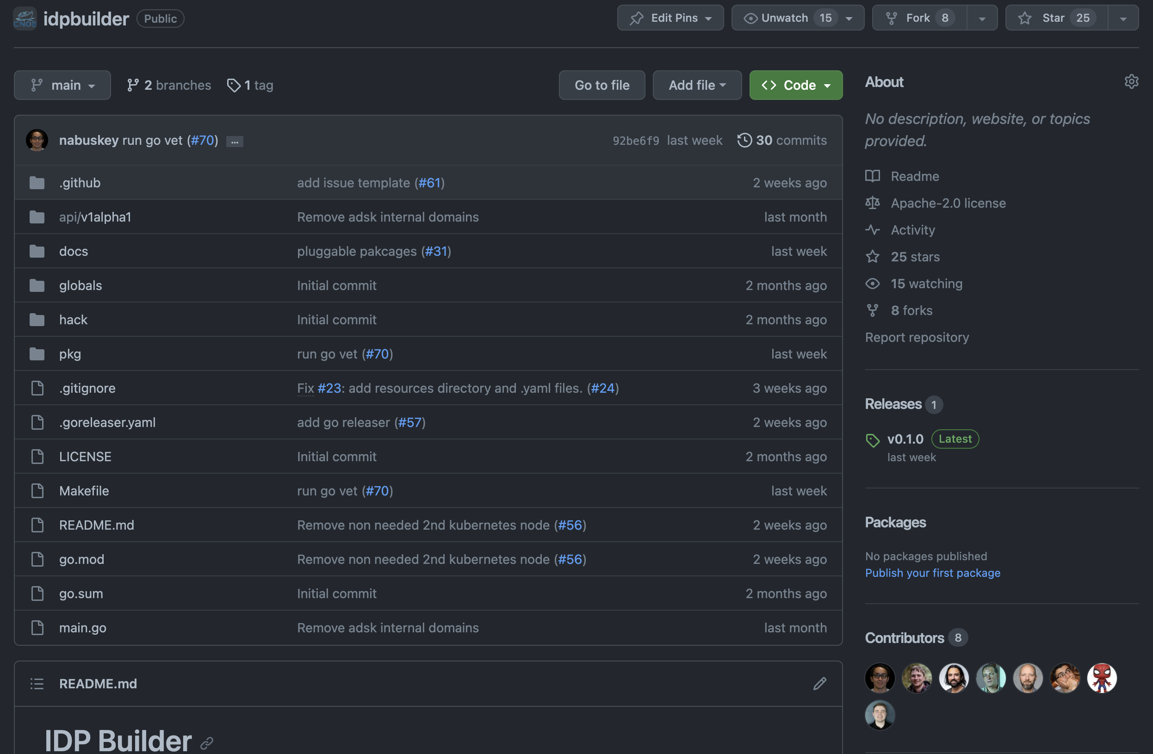
idpBuilder
https://github.com/cnoe-io/idpbuilder

Slide 28
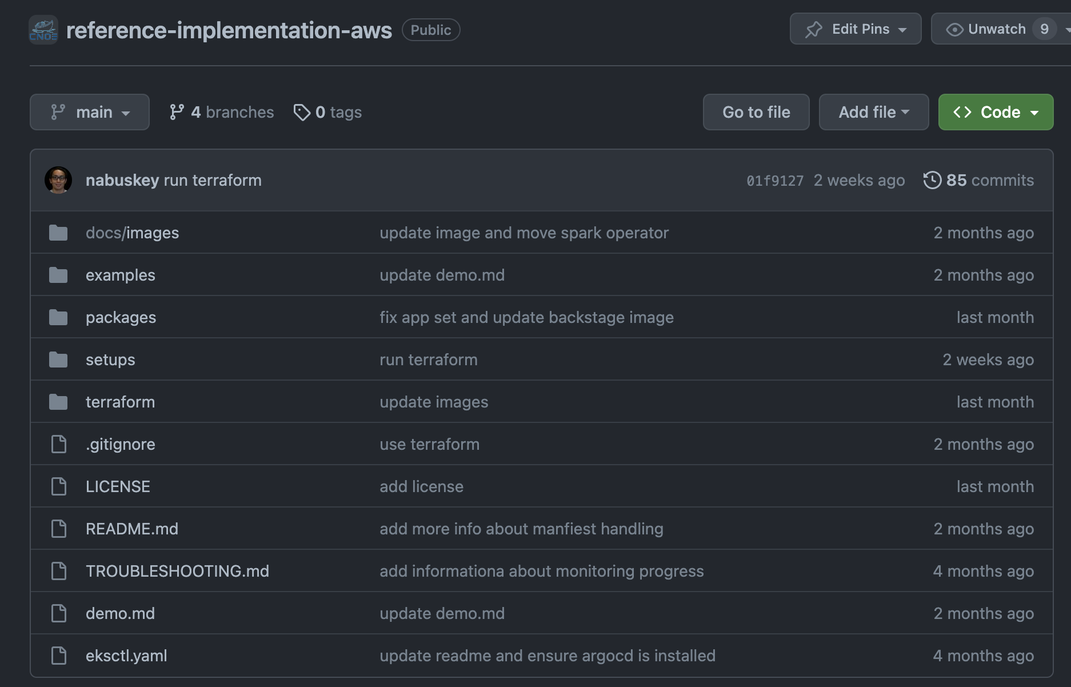
AWS Reference Implementation
https://github.com/cnoe-io/reference-implementation-aws

Slide 29
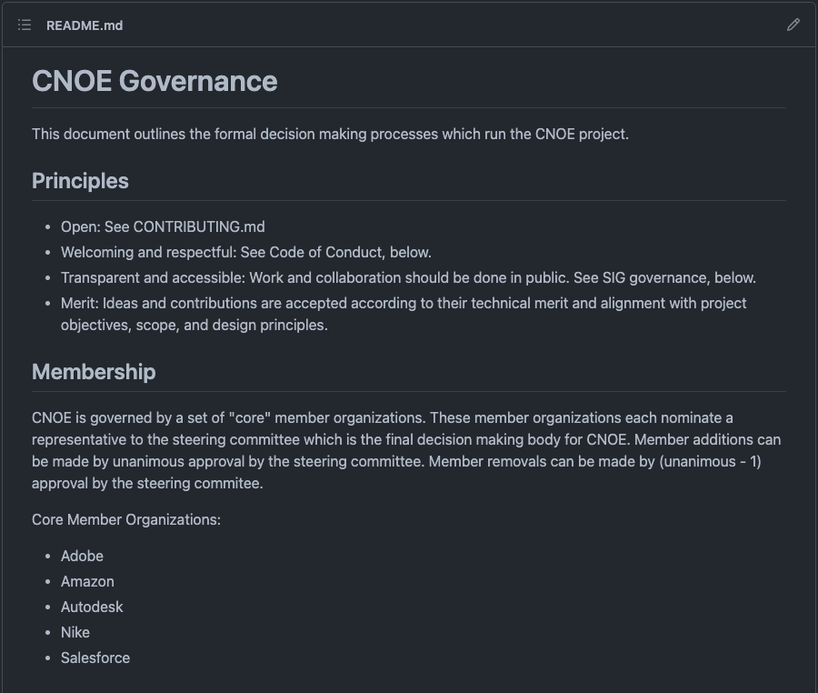
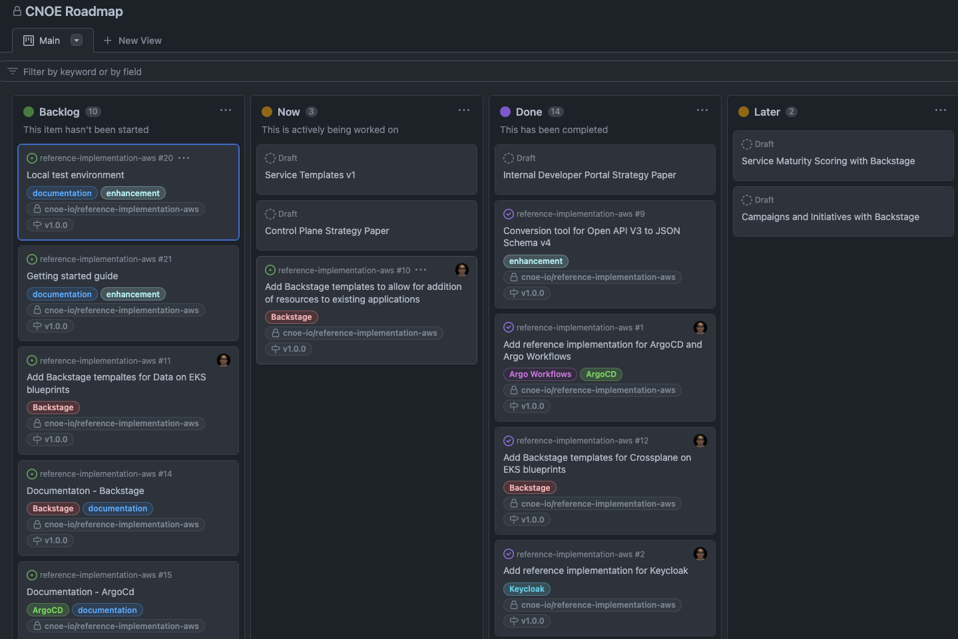
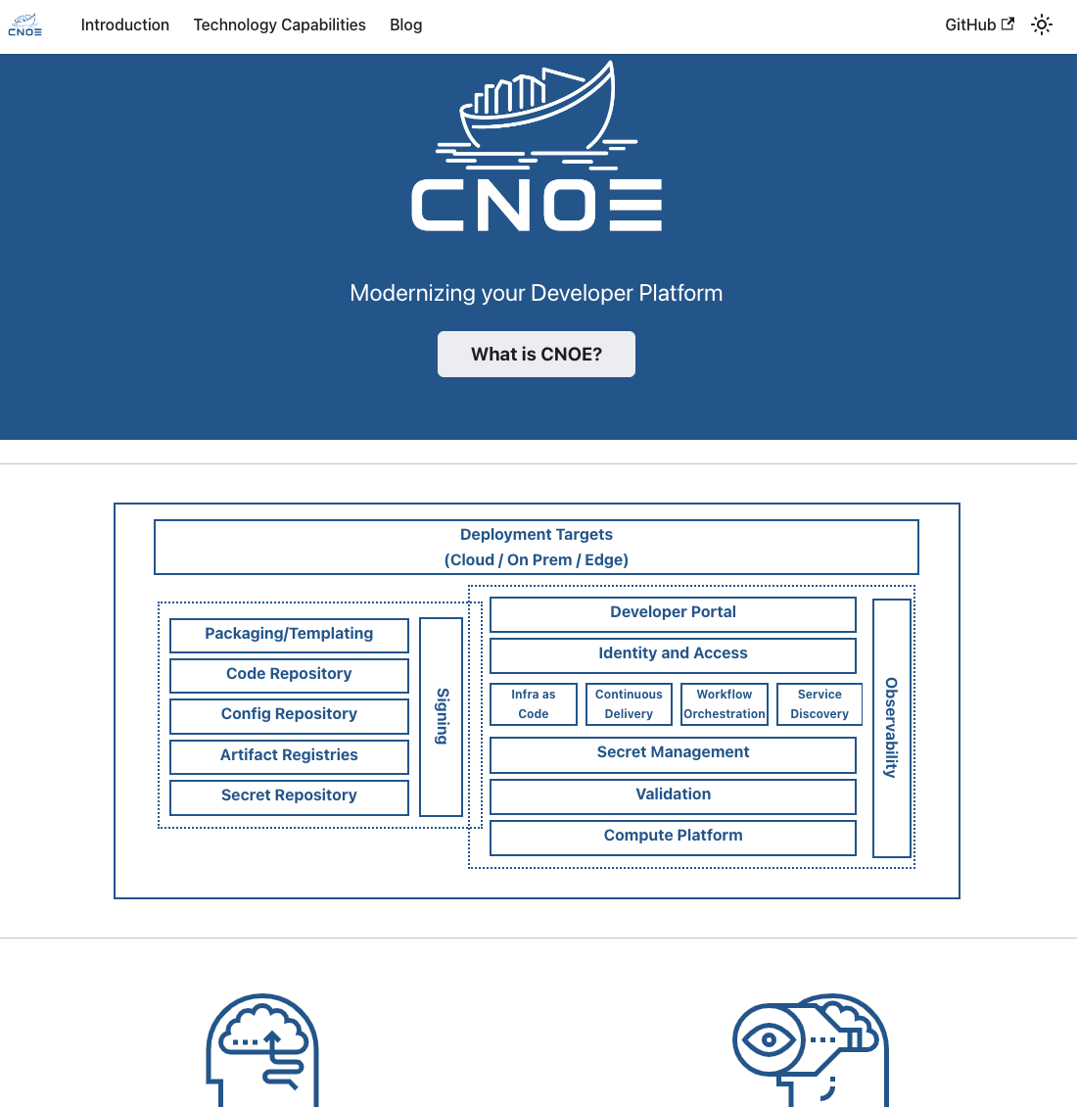
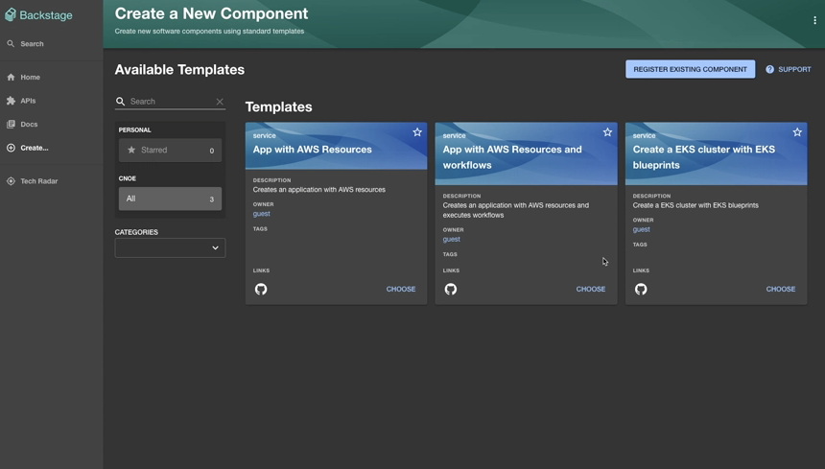
How is CNOE progressing?
The Governance Model
Project Roadmap

Slide 30
Demo

Slide 31



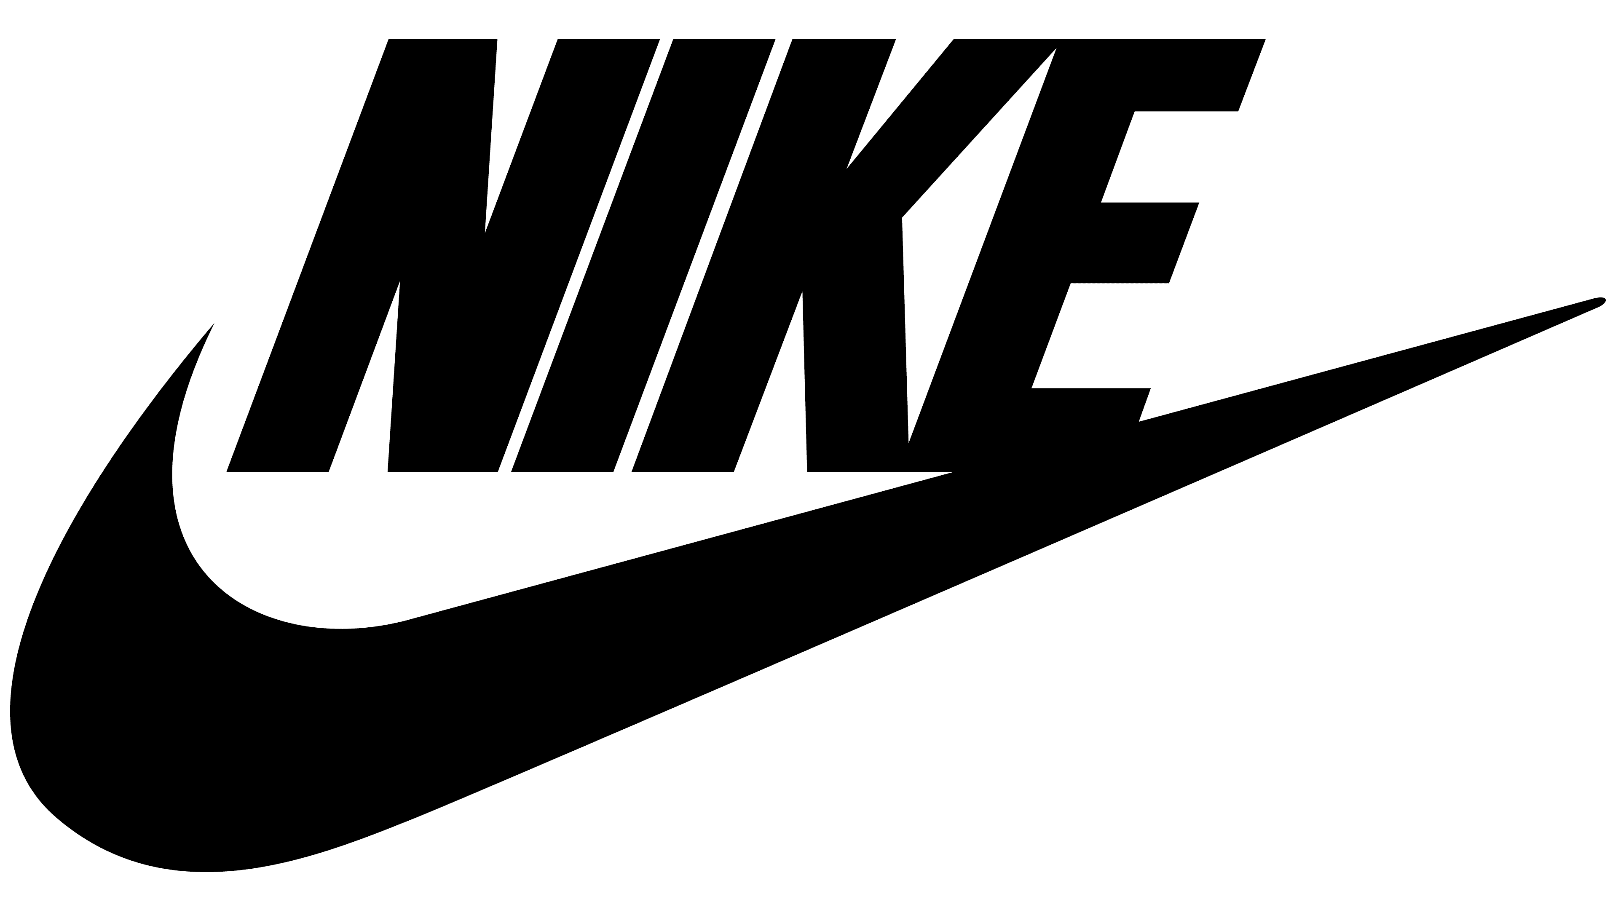

Slide 32
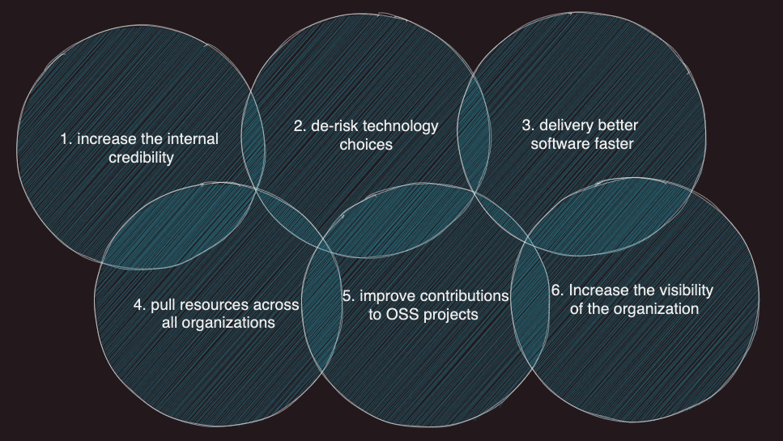
Business Values with becoming CNOE members

Slide 33
Thank you!
http://cnoe.io
Notes:
Legacy systems have grown to be bloated and contributions have fallen behind in lieu of lighter more modern tools (i.e., ArgoCD, Flux, Tekton) that focus on newer paradigms like GitOps.

